Slide 1


ONLINE CHARITY SYSTEM
“We provide a global platform to celebrate and thank individuals who donate voluntarily, for altruistic reasons and without any monetary reward.”
MADE BY:
ANUBHAV B-4 NAVNIDHI B-3
RIYA B-3 DEEPAK B-3

Slide 2
USABILITY
ONLINE CHARITY SYSTEM
VERY USER FRIENDLY.
QUICK ASSESS TO DONATE AS WELL AS GET DONATION.
EVERYTHING IS ON SURFACE.
FAST AND COMPATIBLE.
EASY TO OPERATE.

Slide 3
FLOW CHART
ONLINE CHARITY SYSTEM
START
IS DONATING OR GETTING DONATION?
DONATING
ENTER DETAILS
ENTER SIGN UP
DETAILS
GET DONATION
SAVES DETAIL IN DATABASE
SAVES DETAIL IN DATABSE AND REFLECT ON GET DONATION PANEL
SELECT AND CLAIM ITEM
LOGIN DETAILS
POPS UP NOTIFICATION,SENDS EMAIL AND EDIT DATABESE
END/HOME
MATCHES LOGIN DETAILS WITH DATABES
END/HOME

Slide 4
BLOCK DIAGRAM
ONLINE CHARITY SYSTEM
REGISTER
SIGN UP
HOMEPAGE
FOR ADMIN
FOR USER
FOR USER
ADMIN LOGIN
DONATION
PANEL
GET DONATION
PANEL
ADMIN PANEL

Slide 5
CLASS DIAGRAM
ONLINE CHARITY SYSTEM
CONNECTIVITY
CLASS
SIGN/UP
&REGISTER
WELCOME
DONATE
GET DONATION
ADMIN LOGIN
EMAIL
PRODUCT DISPLAY
ADMIN PANEL

Slide 6
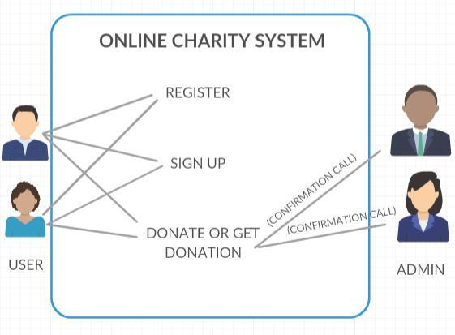
USE CASE DIAGRAM
ONLINE CHARITY SYSTEM

Slide 7
NEW FEATURE OF THE PROJECT
ONLINE CHARITY SYSTEM
USER CAN DONATE ITEMS RATHER THAN MONEY.
USER CAN ADD IMAGE.
AUTOMATED EMAIL UPDATE.

Slide 8
SPECIFIC CONTRIBUTION
ONLINE CHARITY SYSTEM
ANUBHAV ANAND → COMPILATION, EMAIL, GET DONATION, ADMIN PANEL, DONATE ITEMS.
DEEPAK SHARMA → DATABASE HANDLING (MySQL), PHOTOSHOP EDITING.
RIYA MISHRA → DATA-BASE CONNECTIVITY, GUI DESIGNING.
NAVNIDHI SHARMA → LOGIN AND SIGN-UP.

Slide 9
FUNCTIONALITY OF PROJECT
ONLINE CHARITY SYSTEM
ALLOWS CONSTANT UPDATE AND DELETE ON PROJECT USING ADMIN PANEL.
EMAIL FEATURE TO NOTIFY EACH ADMIN ON WHILE GETTING DONATION.
EVERYTHING CAN BE EASILY OPERATED USING GUI.
DATA CAN BE STORED USING DATABASE CONNECTIVITY.

Slide 10
LIMITATIONS OF PROJECT
ONLINE CHARITY SYSTEM
WE DOES NOT ACCEPT MONEY.
IT IS CURRENTLY NOT ON INTERNET.

